Slide 1
Brief Overview of Data Processing of Afghanistan Household Listing,
Pilot Census Results, Population and Housing Census and NRVA Survey

Slide 2
Outline :
- CSO Data Processing Center
- Data Capture for
a. Household Listing Data
b. Pilot Census Data
c. Population and Housing Census Data
d. National Risk and Vulnerability Assessment Survey

Slide 3
CSO Data Processing Center
The CSO Data Processing Center was built to facilitate Census and Surveys data processing. Specifically, the data processing Center is being used for:
As a reception area sufficient to receive 5 million census forms from the field.
As a space for checking and editing of questionnaires.
As a space for coding the entries in the questionnaires.
A s a data entry area ( for 175 workstations for Data Entry.(
A mapping and cartographic area.
A data analysis area and meeting room.
A server room.

Slide 4
Software used for Data Entry and Data processing of Household Listing results
Household Listing was conducted in the country for the purpose of :
  Preparing cartographic material and coding frame
  EA and CA delineation for the census.
  Estimating population and patterns of settlement
CSPro 2.5 was used for the Data Entry and Data Processing of Household Listing results (2003 – 2005)

Slide 5
A total of 20 microcomputers were used for the data entry of the household listing data. There was one computer used as a server and two computers for editing and error checking.
As soon as the household listing questionnaires were received form the field, manual data editing and coding were done and subsequently sent to Data Capture section for data entry.
There were three forms that were processed - Household Listing, Field Condition Form, and Household Sample Form. The three forms were designed based on CSPro 2.4 and its CSentry application.

Slide 6
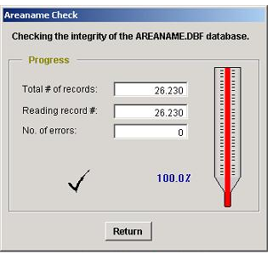
CSPro 2.5 and Foxpro 8.0 were used for the checking and tabulation of household listing data. The two softwares were customized for Afghanistan Household Listing data checking and tabulation (AreaCheck) :
Software used for Data Entry and processing the Household Listing results ……. Continued
Notes:
During startup, immediately after the splash screen is closed, AreaCheck will validate the integrity of the AreaNames file. The AreaNames database plays an important role in the application. Not only is it used during completeness check to test Household listing batches for invalid or missing areas, but it also provides the area names for the various tables

Slide 7
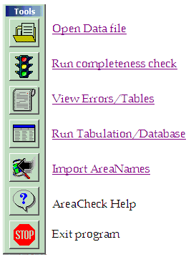
Area Check toolbar
All the functions incorporated in AreaCheck can be launched from the toolbar. The toolbar consists of seven icons..
It should be noted that the Run completeness check and Run Tabulation/Database icons are initially disabled. They will only become enabled when a data file is opened.
Software used for Data Entry and processing the Household Listing results ……. Continued

Slide 8
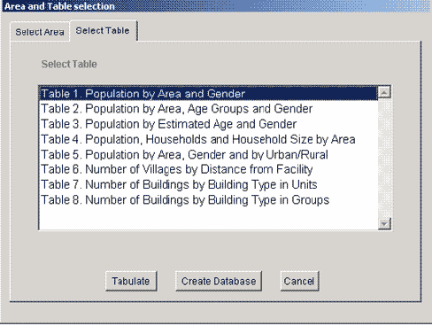
Software used for Data Entry and processing the Household Listing results ……. Continued
Areacheck application allowed the tabulation of the following tables extracted from Household listing data file :
Notes:
The Tabulation icon opens a window from which the user can select tables and areas for tabulation. At present eight different tables are available which can be tabulated on Country, Province and District level. An exception is Table 5 which can only be produced for the Country and Provinces. Additional tables may be included at a later stage.

Slide 9
Software used for Data Entry and processing the Household Listing results ……. Continued
Batch editing application was done using CSPro 2.5.
The batch editing application identified errors and missing values in the data file and then these errors were manually corrected.

Slide 10
Pilot Census 2007
During the Pilot Census, two questionnaires were used ( Household Questionnaire and Housing Questionnaire)
CSPro 3.1 version was used to create data dictionary
As soon as the Questionnaires were received from the field the teams manually edited and coded the questionnaires prior to data entry. Manual coding and editing of census documents were done according to instruction manual
Data Entry Application for data capture was developed based on CSPro 3.1 using logic advantage of CSPro for rational check

Slide 11
Pilot Census 2007 ………..Continued
Around 15 workstations were utilized for data entry and verification of Pilot Census data
The data files from each workstation were concatenated to create a single data file (called raw data file).
The concatenated data files were validated by running CSPro Batch editing application in order to generate Clean Data files
The Clean Data files were used for tabulation of Census tables using CSPro tabulation application and Microsoft Excel
Three workstations were used for program generation, data processing and data analysis
Two workstations were used for monitoring and control

Slide 12
Pilot Census 2007 ………..Continued
Due to lack of data processing expert at the time of Pilot Census, editing and imputation were done manually

Slide 13
The Afghanistan Population and Housing Census
Census is crucial to Afghanistan because of the following reasons:
It will provide basic socio- economic data required for post – war reconstruction in the country
It will provide data to ensure equitable distribution of resources in terms of gender and other factors
It will provide statistics critical for local area development .

Slide 14
Census data processing
Enormous volume of questionnaires
Complexity of problems in the data vary. Thus, data validation and editing sometime require complex procedures.

Slide 15
Data processing tasks for Afghanistan Population and Housing Census 2010
Pre – processing checks and controls for ensuring area coverage prior to data entry and further processing
Data entry and initially 50% data entry verification
Manual editing and coding

Slide 16
Data processing tasks for Afghanistan Population and Housing Census 2010
Computer editing and imputation will be designed.
The HOTDECK imputation method will be used

Slide 17
Afghanistan Population and Housing Census 2010 Data Processing
Traditional Data Entry will be used
150 desktop computers will be procured for data entry
12 desktop computers will be used for program development for data processing, tabulation, and data analysis
CSPro software will be used for data entry and verification
Appropriate data processing software which will be used for tabulations and data analysis will be procured
About 200 persons will be utilized for data entry and verification (on 2 –shift basis)

Slide 18

National Risk Vulnerability Assessment Survey
(NRVA) 2005 and 2007

Slide 19

What is Teleform ?
TeleForm automates the entire process of data capturing, evaluating, validating, and storing data. TeleForm can create data collection form, distributes them via fax server, printer, or the Internet, then automatically evaluate the returned data. After interpreting the results, TeleForm can export this information to a database.

Slide 20
Teleform Modules
Designer
Reader
Scan Station
Verifier

Slide 21
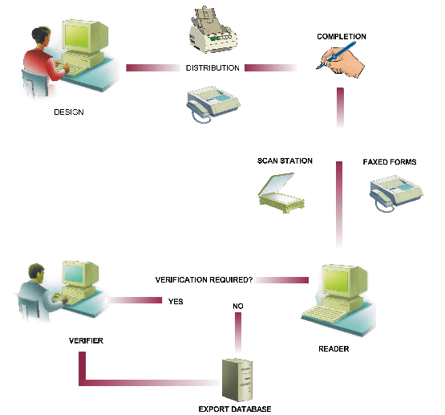
Form Processing

Slide 22
Designer
TeleForm Designer’s intuitive user interface make it easy to create templates to capture any type of data.

Slide 23
Scan Station
TeleForm’s Scan Station turns completed pages and files into batches that can be processed by Reader and Verifier. Using Scan Station is the first step in taking advantage of TeleForm’s powerful batch processing feature, which handles large groups of items efficiently and accurately.

Slide 24
Reader
TeleForm Reader evaluates image files automatically, eliminating the need for manual sorting.
At the most simple level, TeleForm Reader is a product that classifies and evaluates image files by comparing them to templates created in Designer.

Slide 25
Verifier
TeleForm Verifier operators can:
Check or correct any data entry fields that were not evaluated with sufficient confidence by Reader

Slide 26
Scanning Data Capture
(Teleform) NRVA
Cost: full installment, server, workstation and software around US $100,000
Time to process: scanning of 100 page questionnaire for 1700 households takes 20 days
Interpretation versus : one form consist 38 pages takes 2 minutes
Technical personnel : CSO doesn't have enough technical personnel for the scanning technology

Slide 27
Problem on image or character interpretation: we have problem with dari character, which teleform could not recognize
Problem in the form used in the field: we have problem with dusty and broken forms. Every day scanner has to be cleaned. Filled out dusty and broken forms have to be transcribed to new forms
Enumerators have problem in hand writing

Slide 28
Thank you

